Slide 1
Virtualized Networking (Andromeda)
Leonidas Kontothanassis

Slide 2
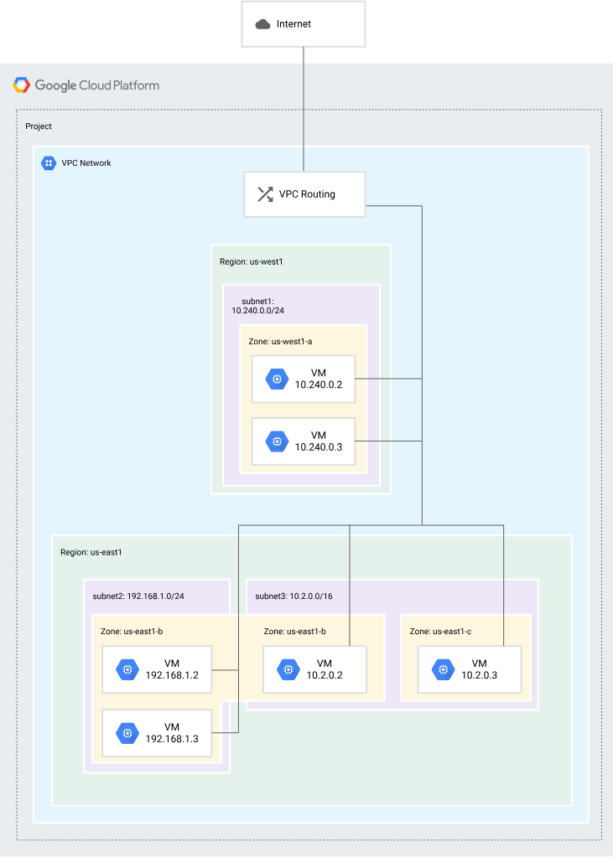
What is the problem?
My Network
Your network

Slide 3
It’s a big problem (#projects vs #customers)
You could have >1,000,000 VMs in a DC with >10 million routes
Assume 100K projects, 10 VMs/projects with 100 active routes/project and you can see the scale of the problem.

Slide 4
What is the problem
Performance isolation
Scalability
Rapid provisioning of hosts and subnets
Hardware level latency and bandwidth
High availability and development velocity

Slide 5
Key concepts
Programmable Data Plane with direct connectivity for the few high bandwidth communication flows
Gateways for long tail of low bandwidth flows
Coprocessors for functionality that is expensive and/or not related to packet forwarding
Packet encryption, processing of network samples for security, DoS etc…
The Andromeda paper

Slide 6
Background (OpenFlow and SDN)
Data Plane: All activities related to direct packet management
Forwarding
Fragmentation and reassembly
Replication for multicasting
Control Plane: All other packet related activities
Making routing tables
Setting packet handling policies (i.e. firewalls)
Advertising services
Management Plane (provisioning and monitoring)
Add new devices
Add new protocols
Deal with faults, repairs etc.
Services Plane (Value add ons, not always present)
Proxies, Intrusion Detection, SSL offload etc.
Notes:
Data Plane (move packets)
Control Plane (tell the Data plane how to move packets)
Management Plane (manage the devices that move the packets. You would not need it if you only provisioned/deleted VMs)
Services Plane (other value add networking features).

Slide 7
OpenFlow Basics
Header Fields | Counters | Actions
Header Fields | Counters | Actions
… | … | …
Header Fields | Counters | Actions
Ingress Port
Ether Source
Ether Dest
VLAN ID
VLAN Pri
IP Src
IP Dst
IP Proto
IP ToS
Src Ip Port
Dst Ip Port

Slide 8
OpenFlow Basics
Supported by most switches today
Requires central controller to program switch policies
Not a good fit for networks controlled by different entities (see BGP from earlier lecture)
Open vSwitch the virtualized implementation of OpenFlow
Seminal paper in 2008
A pretty nice presentation
Introduction to OpenFlow
Notes:
Openflow actions: Port, All(Flood), Controller (send to software on switch), Local (Traditional switch networking stack), In-port, drop, group actions.

Slide 9
Andromeda Data Plane
Encapsulation
Since all addresses are in 10.X.X.X space we need to know which project they belong to
Use IP encapsulation
Embed the IPv4 in IPv6. Separate IPv6 prefix for each project so no conflict!
The IPv4 becomes the lowest part of the IPv6
The Hypervisor knows to strip it out and deliver to the kernel inside the VM
There are other way of encapsulation like GRE, VXLAN, IPSec as well.
Notes:
Here

Slide 10
Andromeda Data Plane
Fast path
Examine if packet belongs to fast path flows
Forward packets for non-fast path flows to gateways called Hoverboards
Processing of fast path packets not related to forwarding delegated to co-processors (accounting and counter)
300 nsecs per packet budget!
For N VMs there are N^2 flows. Only a tiny fraction of those have need for fast path
Notes:
Here

Slide 11
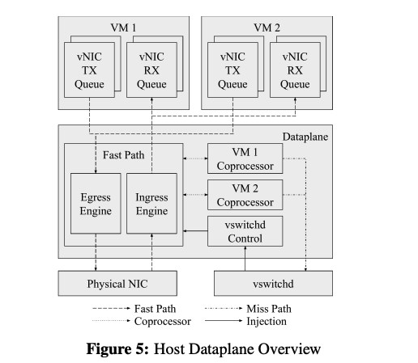
Data Plane Design
Fast paths maintains cache of forwarding state and packet processing logic
On a miss, packet is sent to vswitchd which can update fast path state and re-inject packet
Notes:
Explain the flows, how stuff goes through the fast and vswitchd. FastPath has the top N flows in an LRU cache. Sends packet to destinations based on what its cache says. If not in cache talk to vswitchd. Vswitchd may know how to send direct or may install a forwarding rule saying “send to hoverboard”. Vswitchd also records which of those flows have high usage and may upgrade them to send direct.

Slide 12
The Flow Table
Avoid complicated data structures (use arrays as much as possible). One has lookup from map flow keys to flow indices
Updates never in place
Make new Flow Table with relevant information and atomically swap pointers from old to new

Slide 13
Andromeda Control Plane
Fabric Management Layer
Handles the aggregate configuration for a cluster
Delegates to VM and LB controllers actual instruction of what to configure
VM and LB controllers talk to VM host switches to install rules
Switch Layer
Base on Open vSwitch receives programming from FM and applies OpenFlow to program the datapath
Additional functionality added for billing, security, sticky load balancing etc.
Notes:
Why two? Fabric deals with the higher level operations as you see them in the console. Switch deals with the low level hardware and their variations.

Slide 14
Network Programming Paradigms
Preprogrammed model
Consistent predictable performance
Doesn’t scale (N^2 on number of hosts)
Changes in topology require large updates
On Demand model
More scalable but up to a point
High latency on initial packets
DoS prone
Gateway model
Consistent, predictable performance
Control plane scales well
Data plane does not scale!
Hoverboard or Hybrid model
Combination of On Demand + Gateway
Notes:
Talk about the GFE outage I caused that brought Google cloud down (pre-open connections and new QUIC feature crashing all GFE2 instances).

Slide 15
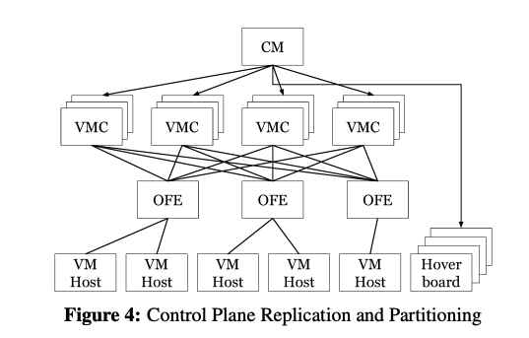
Control Plane Reliability and Isolation
Replicated controllers and OFEs guarantee control plane reliability
No replication of switch layer (hosts are deemed unreliable)
Per customer queues in VMC with round robin processing
Fail Static

Slide 16
Network support for VM migration
Hairpin Flow
VM2
VM1
Initial Flow
VM sees same virtual Ethernet device
VM is paused during migration (~65msec mean, ~400msec 99th percentile)
Hairpinning ensures packets are not lost in network
Buffers on VM host switches preserve packets
TCP control flow guarantees delivery
Final Flow
VM3
VM2

Slide 17
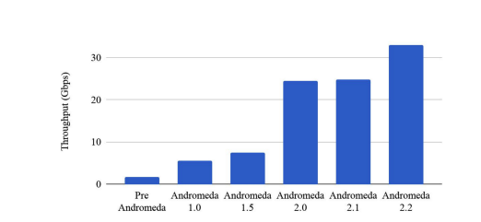
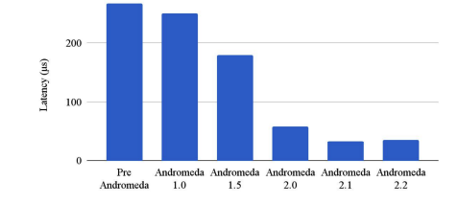
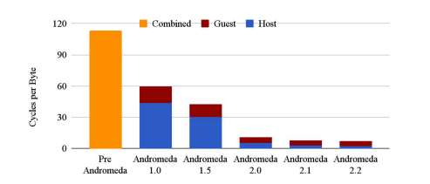
Key Optimizations
Avoid copies
Avoid interrupts and use polling
Batch processing of packets
Offload packetization work to NIC

Slide 18
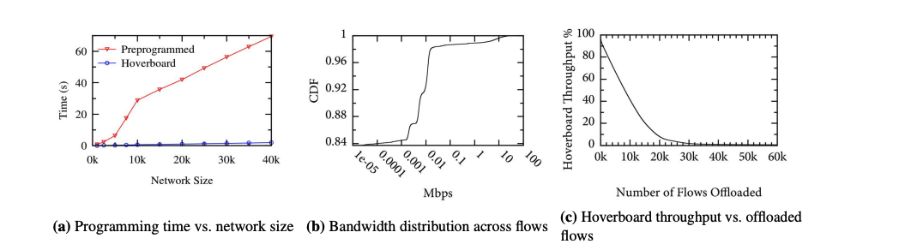
Hoverboard Scaling Analysis
Cost of adding routes very low (essentially rules says forward to hoverboard)
Most routes/flows have very little traffic (98% have < 100Kbps)
Offloading about 20K routes in a cluster gets rid of 90+% of bandwidth from Hoverboard

Slide 19
Upgrading Andromeda itself
Early vSwitch lived in the kernel which made upgrades slow and risky
Move to user space in conjunction with DPDK for agility and speed
During upgrade new dataplane starts and copies state from old dataplane
Once done old datplane stops serving and transfers any deltas to new
VMM connects to new dataplane and resumes sending
Median blackout time of 270msec.

Slide 20
Some other key technologies
DPDK (Intel Data Plane Development Kit)
Technology to give user programs very fast access to NIC data and metadata
XDP (Express Data Path)
Technology to allow users to push (“safe”) programs into the kernel for packet processing
Both meant to allow developers to process network packets efficiently and fast without writing kernel code.

Slide 21
Tcpdump
Leverages XDP (not quite but uses common language)
A great way to see the traffic coming or leaving your host
tcpdump -n -i en0 pcap_filter where pcap_filter can be
type (host, network, port)
direction (src, dst, or combination)
Protocol (ether, ip, ip6, tcp, udp etc)
https://www.tcpdump.org/manpages/pcap-filter.7.html
Let’s see if we can see any packets we are sending to google

Slide 22
Attendance poll
https://piazza.com/class/mkctevprups13o/post/172
For next lecture install docker on your machines:
https://www.docker.com/products/docker-desktop/

